Slide 1

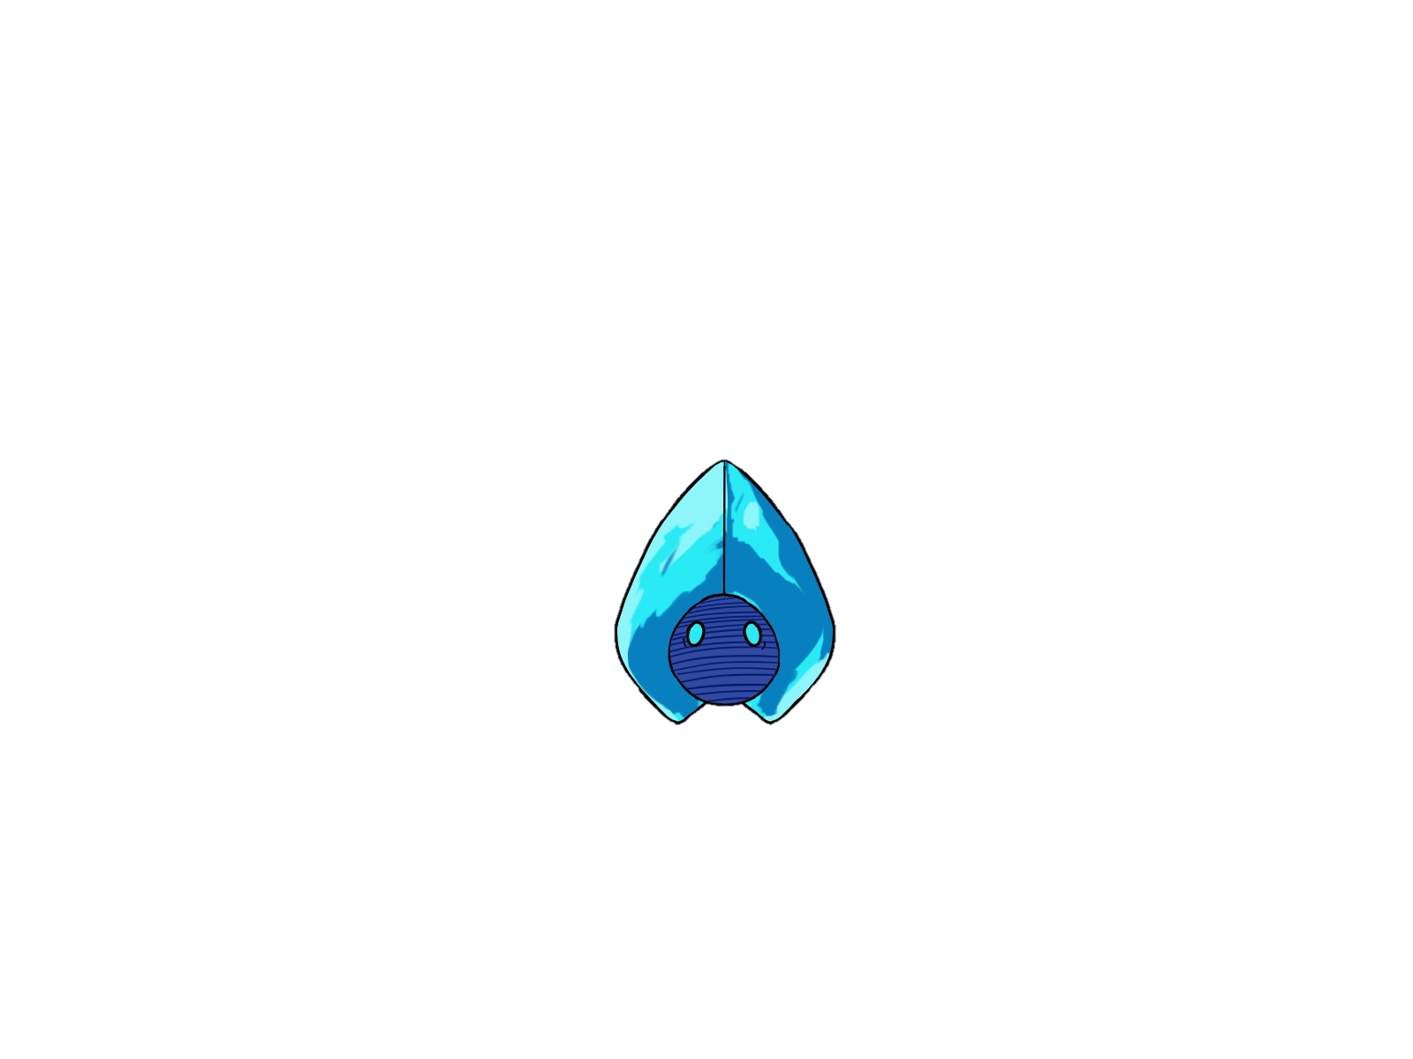
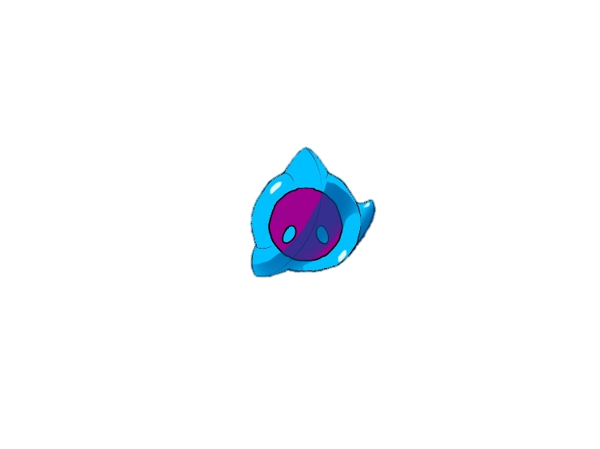
FORGET ME NOT
Used to present your game to an audience
- Provides a guide for presenting a more detailed overview of your game
- Fits the visual theme of the game
- Looks sharp and professional
Contains the following information:
o All information of the One Sheet
o Explains the game direction
o A deeper dive into every aspect of the game
o A deeper dive into the development aspects of the game
o A selection of 1-5 high quality in game or concept artworks
o Slides showing comparable successful titles
o Shows the good side of your game
Moon flower
BY DANIEL BARACOTTI, FREDERYK SPERLING, Alba Pläp Golfe, Sebastian gerena and tamina Brunke

Slide 2
Target Group
15-25 years old
A young, but already mature audience. People who understand the meaning of the connection between emotions.
Casual Gamers
People who like to play from time to time
Pc gamer
People who play mainly on pc

Slide 3



Artist Provide Character and Background sprites
Designer Create level ideas and build levels
Programmer implements the scripts
Development
Artists Provide Character animations and Background sprites
Designers Create level ideas and build levels in unity
Programmer implements game mechanics and level structure

Slide 4
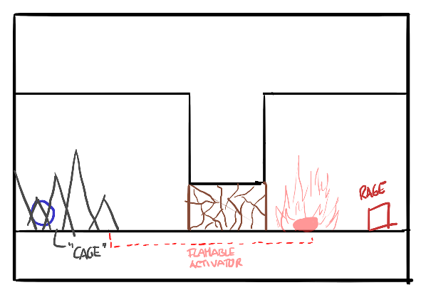
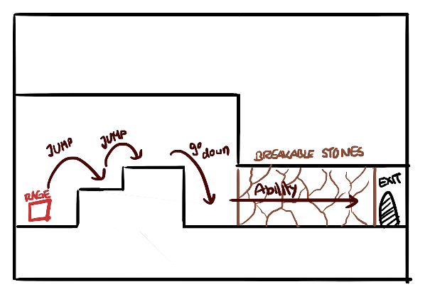
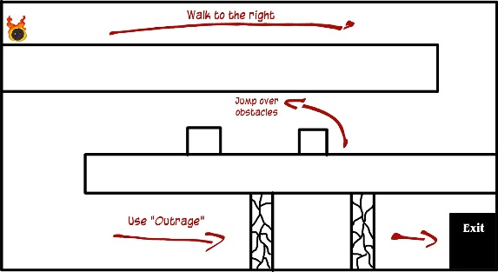
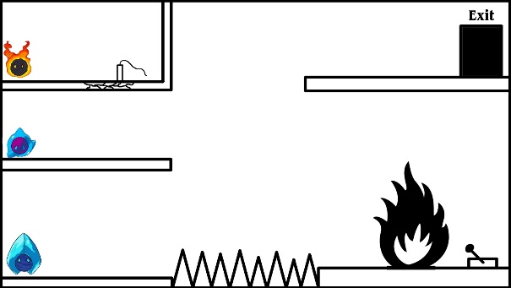
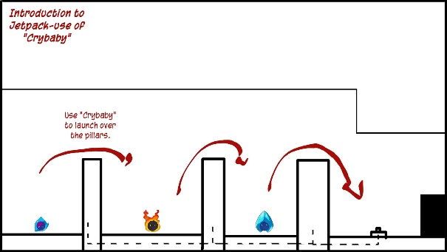
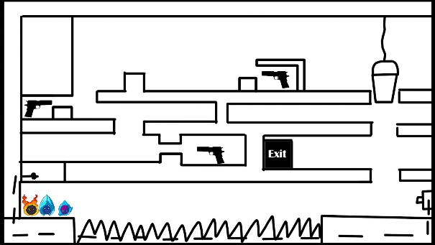
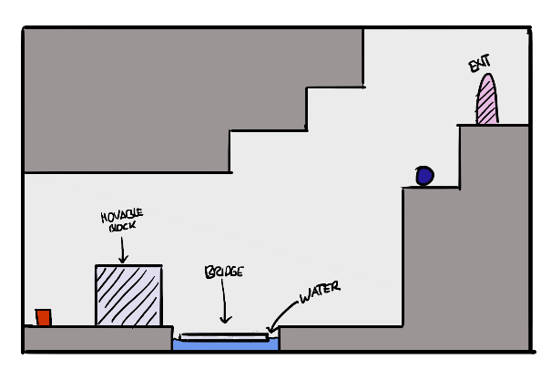
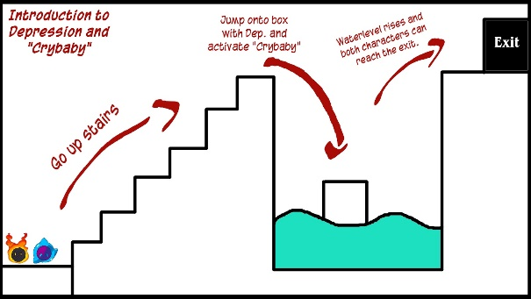
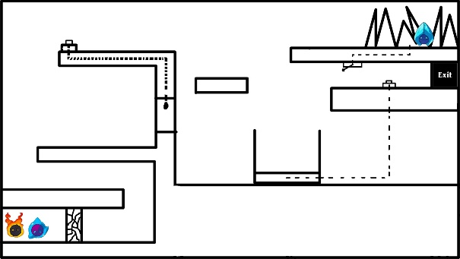
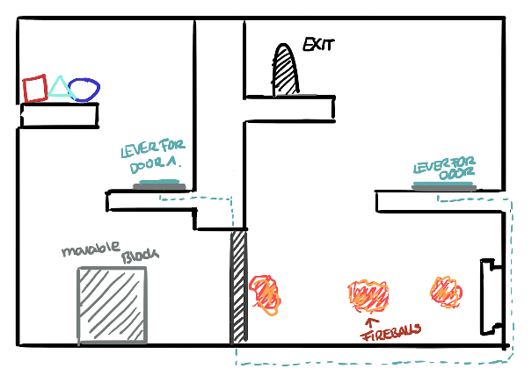
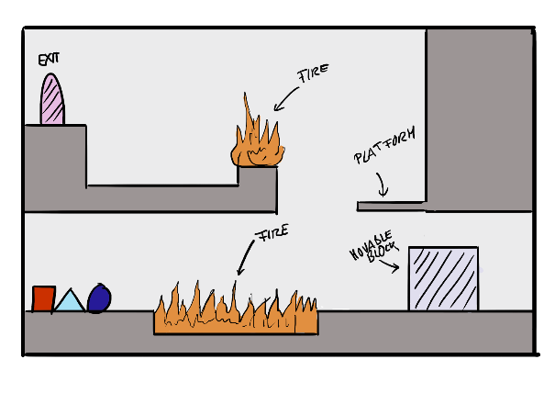
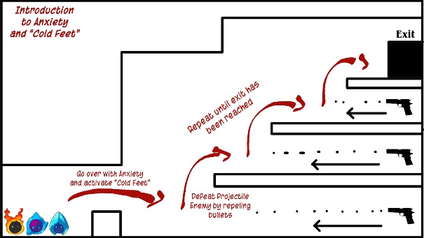
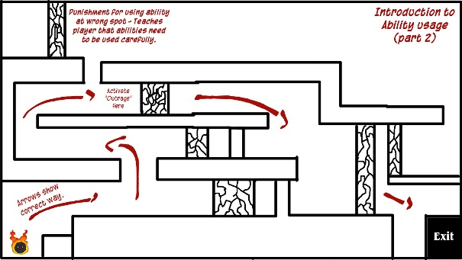
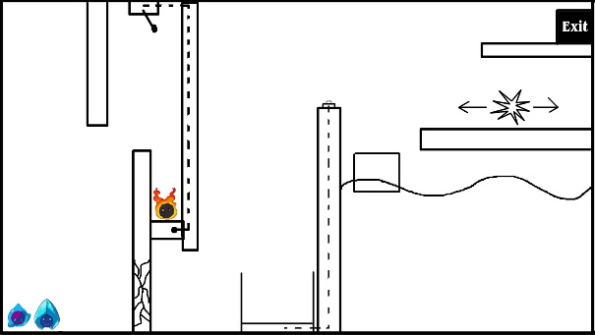
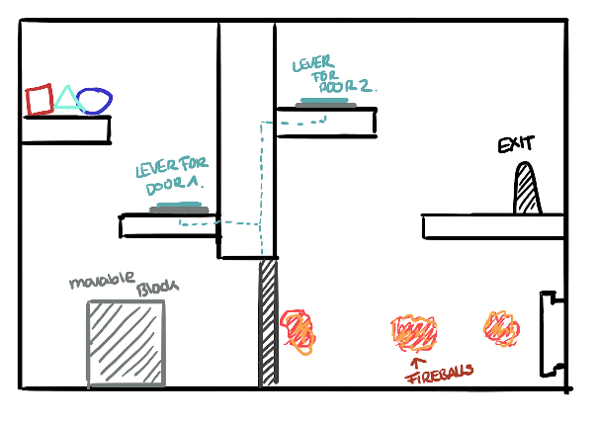
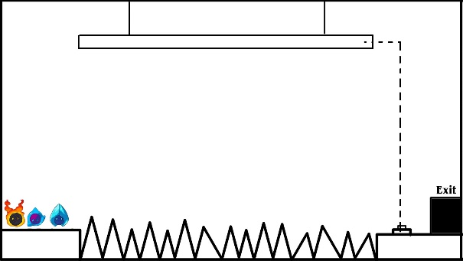
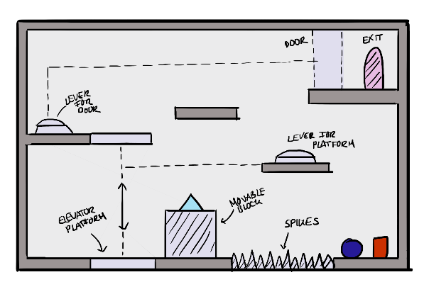
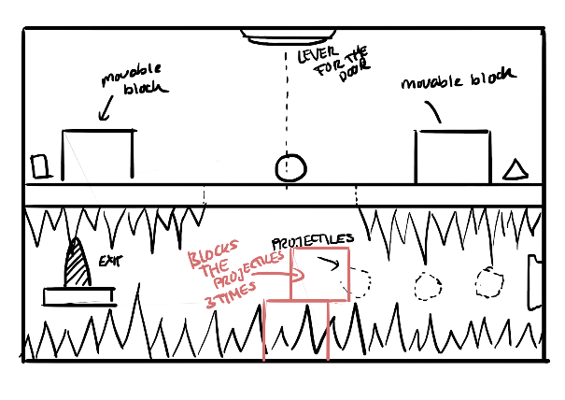
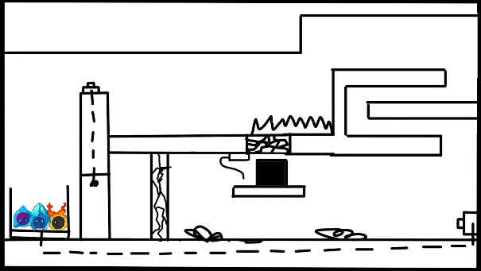
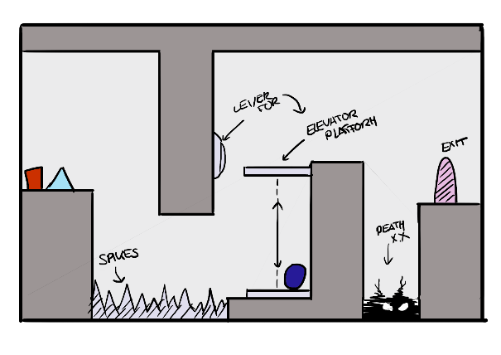
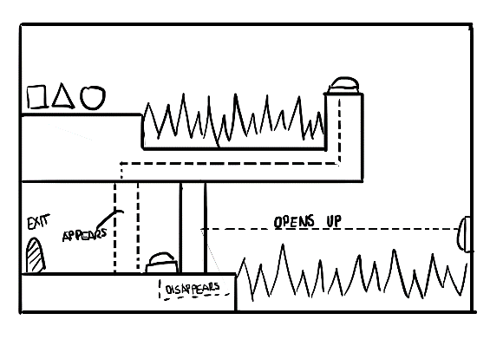
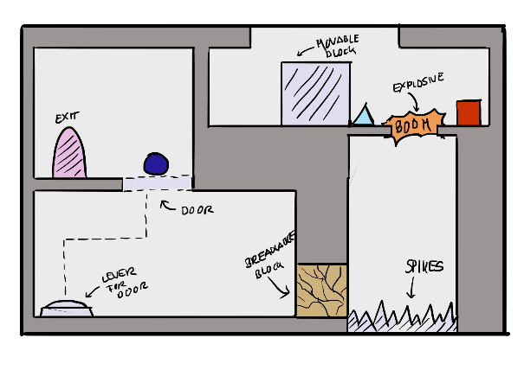
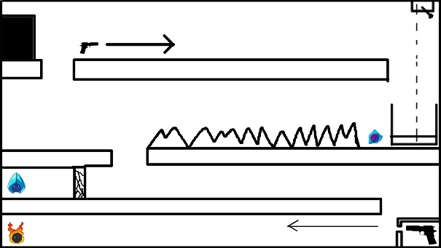
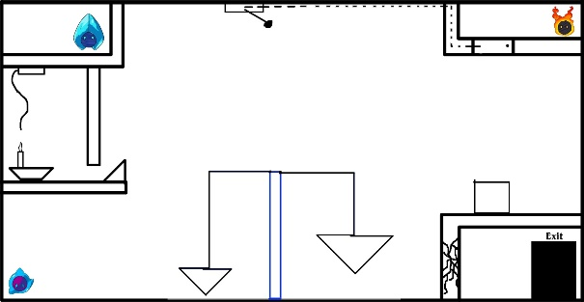
Levels

Slide 5
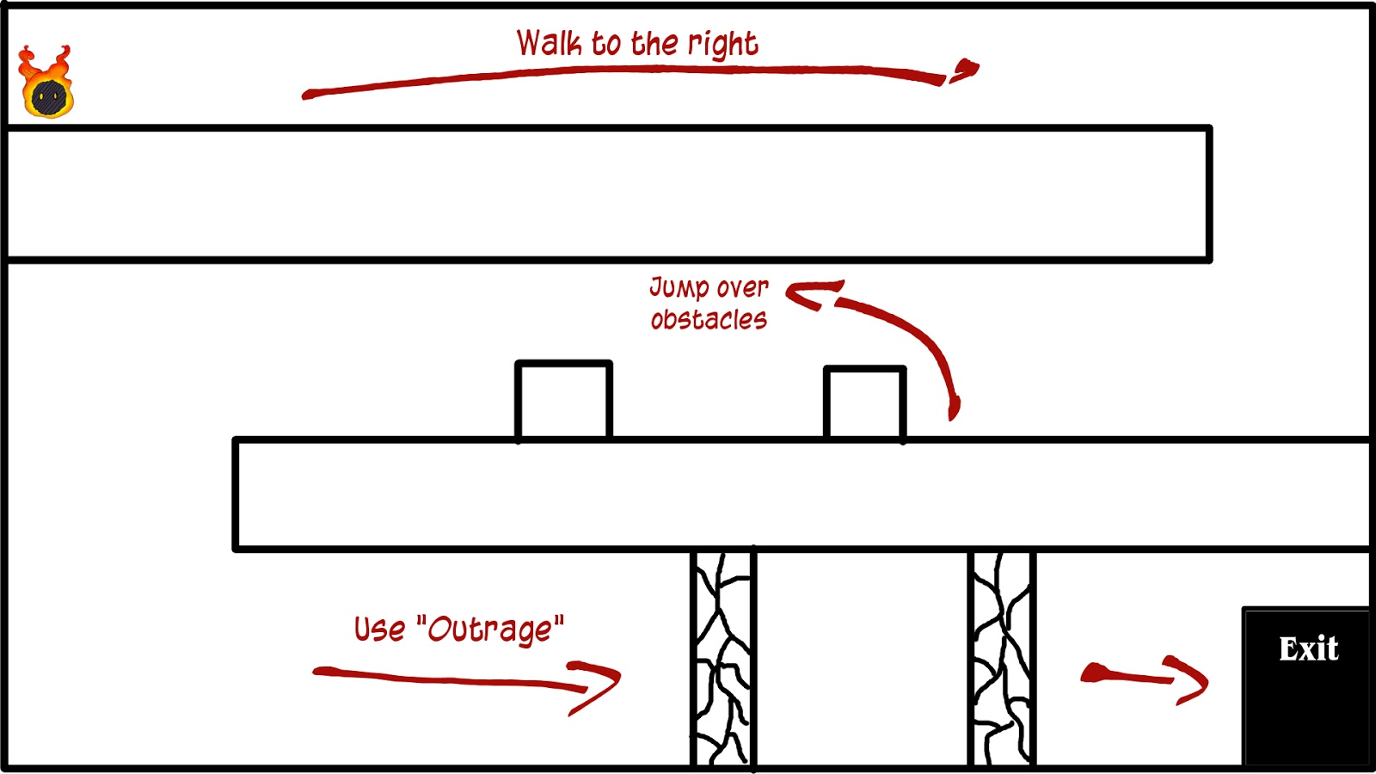
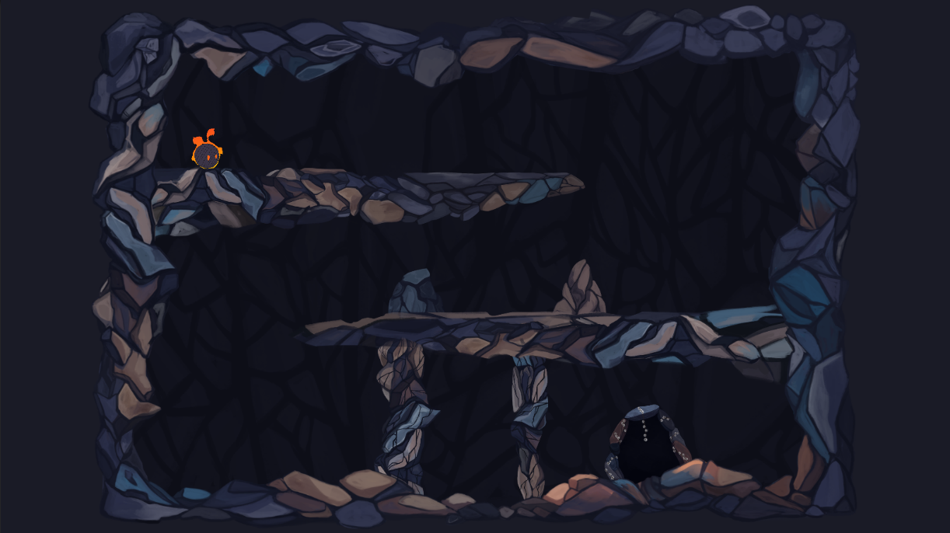
Levels

Slide 6
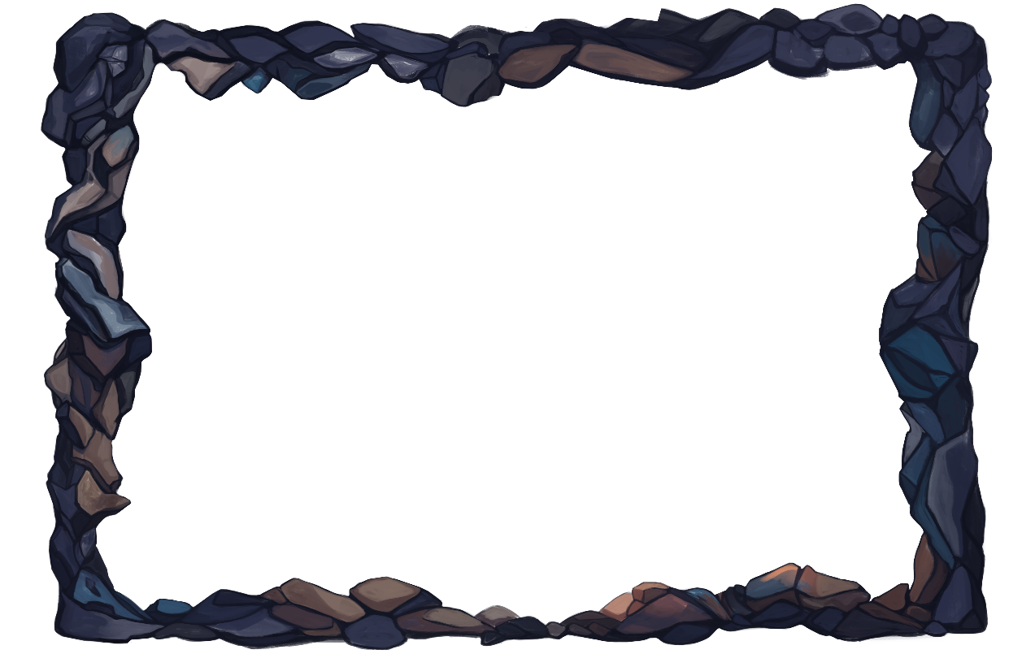
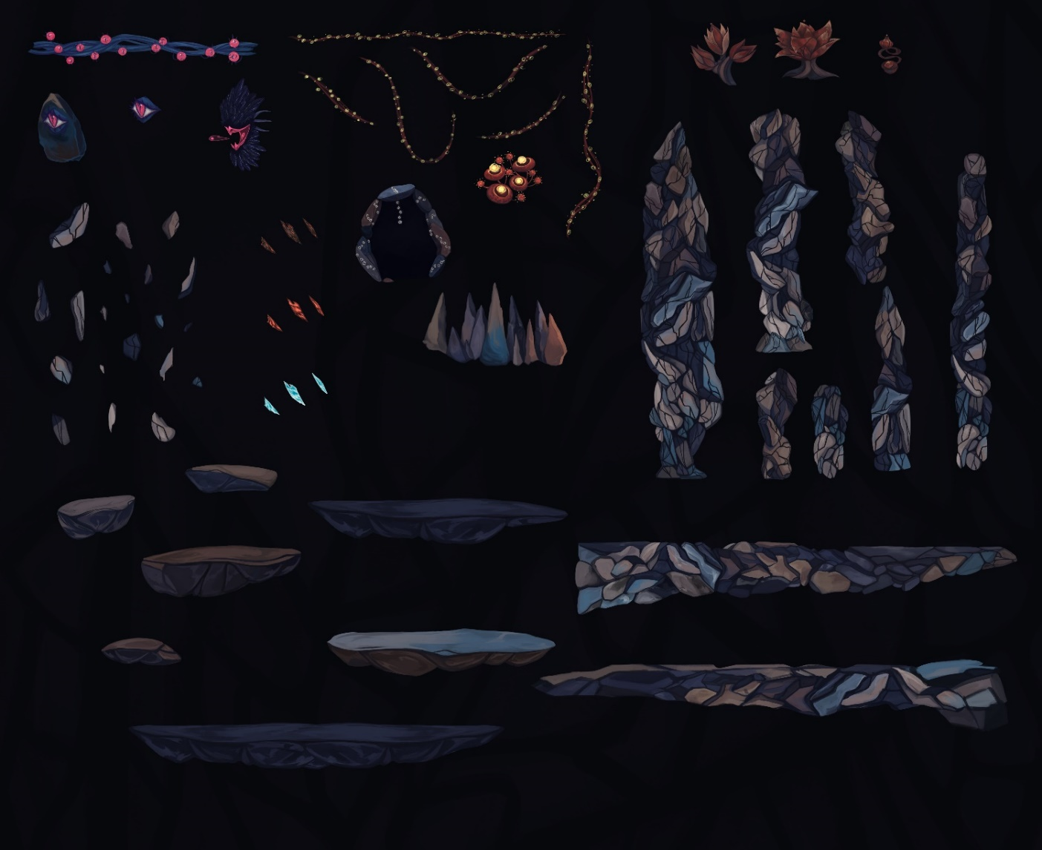
assets

Slide 7
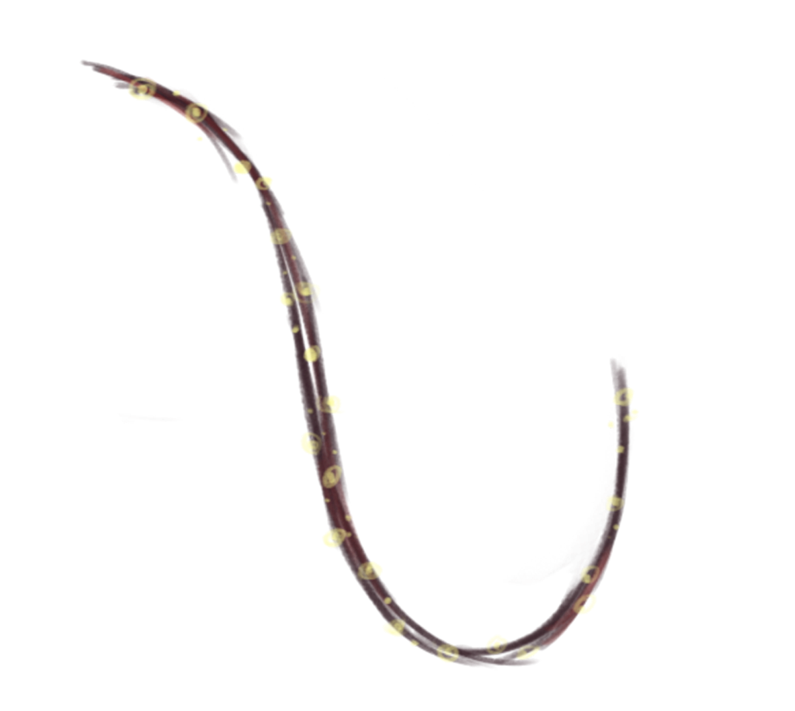
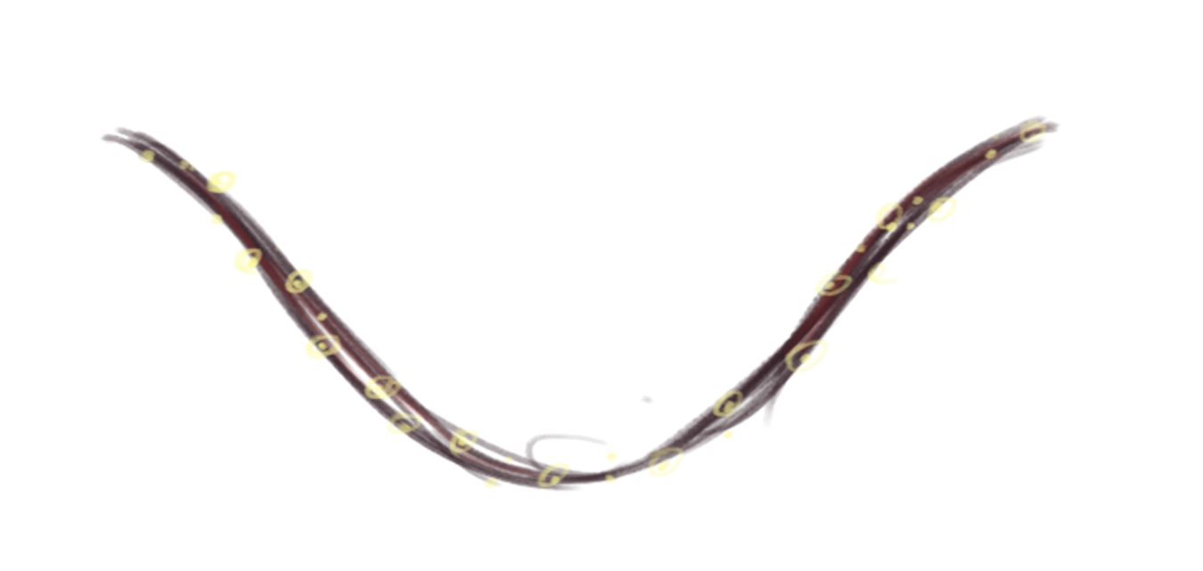
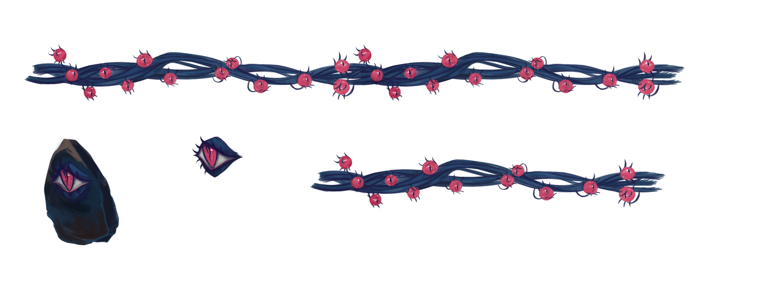
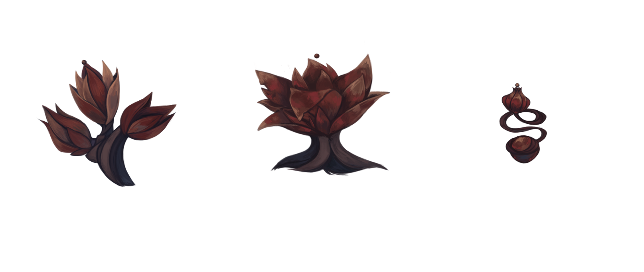
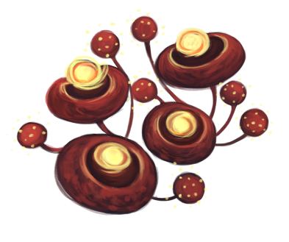
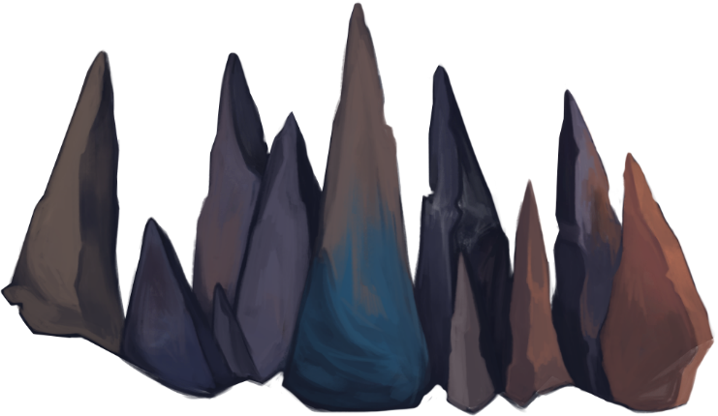
interactables
Fuses
Connect interactable objects
Eye switch
can activate or deactivate interactables like doors or moving platforms
Explosive mushrooms
explode when set on fire
Shooting flower
shoots harmful projectiles
Fire flower
Friendly helper emitting flames
spikes
You touch them – you die.

Slide 8
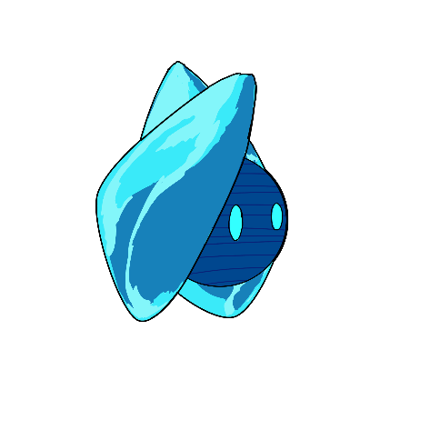
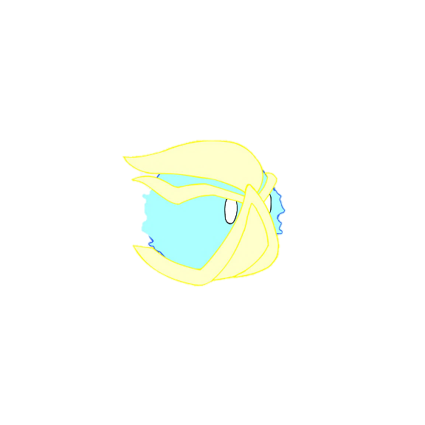
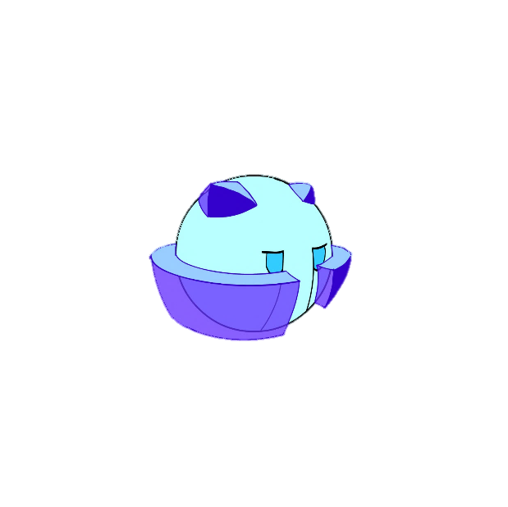

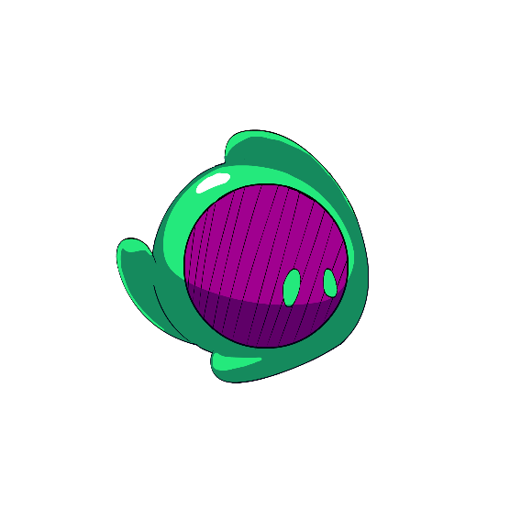
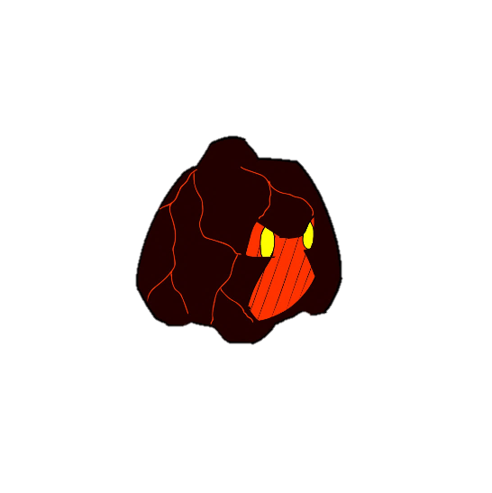
Character And abilities
Anxiety
Rage+Anxiety
Anxiety + sadness
Rage
depression
rage + sadness

Slide 9


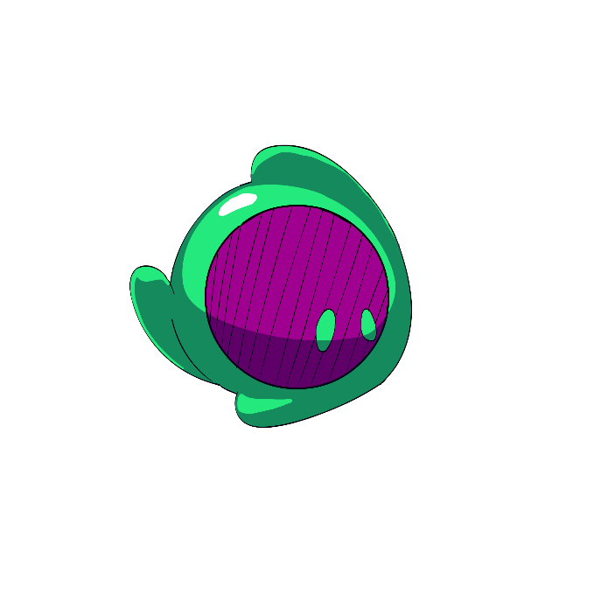
Individual abilities
Rampage
A forward dash making rage’s flames burn stronger
run through breakable obstacles
light flammable objects
Activate explosives
Cold Feet
Makes Anxiety freeze in place.
immovable
Repel projectiles
invulnerable
Can be used as a platform
Crybaby
Makes Depression cry a huge amount of tears.
fill up containers
put out fires
raise water levels
Tear jet-pack

Slide 10
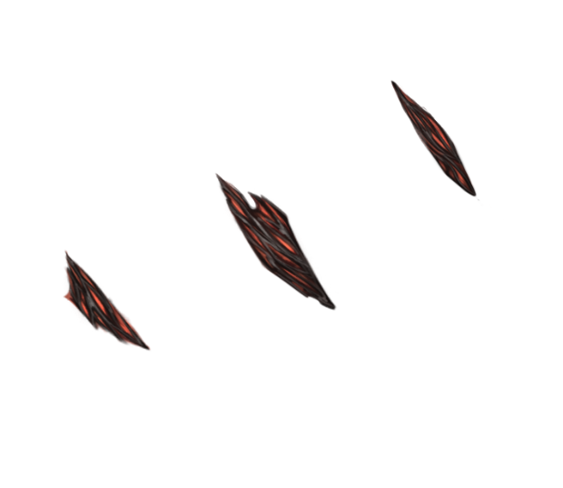
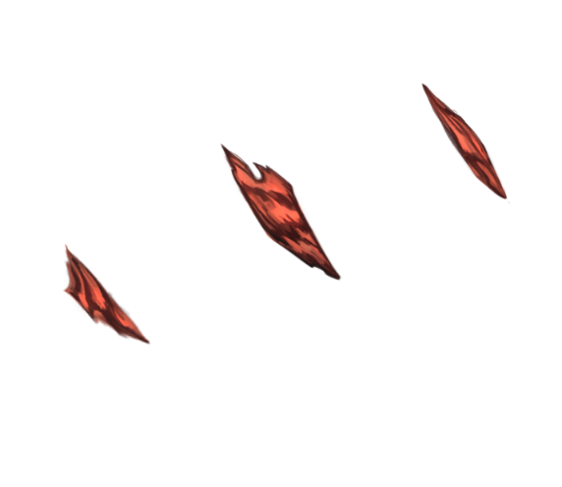

combined abilities
Eruption (Rage&Dep.):
cries magma tears, that harden immediately.
Can be used to create paths
Frozen Outrage (Rage&Anx.):
runs very fast and becomes invulnerable
Can run over hazardous terrain
Can run through enemies to defeat them
Icey Tears (Dep.& Anx.):
can shoot controllable frozen tears.
Can defeat enemies from a distance
Can activate otherwise unreachable mechanisms

Slide 11

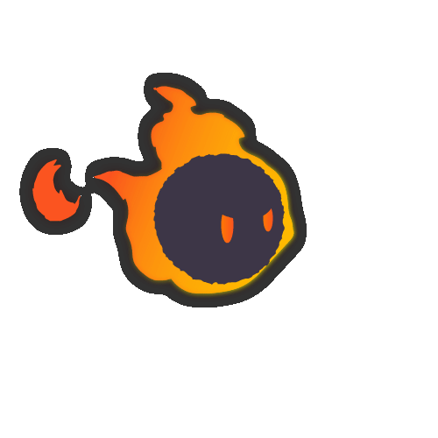
Character Animations

Slide 12
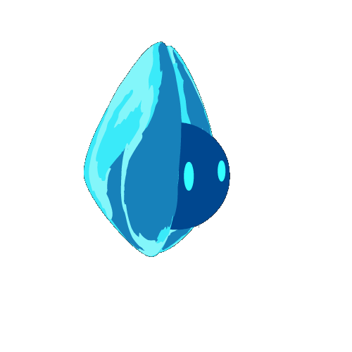

Character Animations

Slide 13
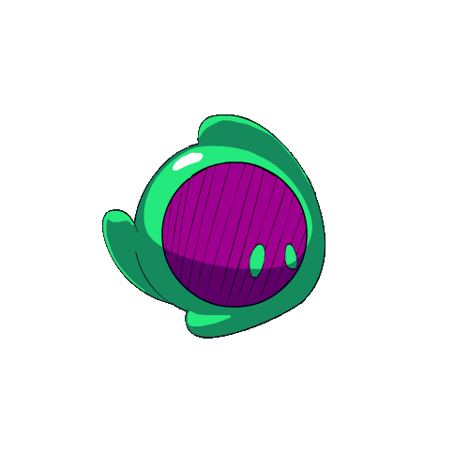
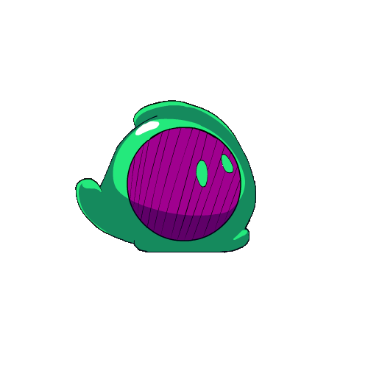
Character Animations

Slide 14
Selling Points
Characters can use both individual and combined abilities!
Creative and unconventional solutions are encouraged!
Broad abilities allow for lots of experimentation!

Slide 15
Daniel Baracotti (Level Design/ Mechanic Design/Documentation) : daniel.baracotti@web.de
Tamina Brunke (Level Design/Framework): taminabrunke@outlook.com
Sebastian Gerena (Character Design/Illustrations): belmontx21@hotmail.com
Alba Plaep Golfe (Project Lead/Environment Design/Illustrations): alba.plaep@gmx.de
Frederyk Sperling(Programming/Sound Design): mail@frederyk.de
Moon flower bold
A b c d e f g h I j k l m n o p Q r s t u v w x y z
FORGET ME NOT…

